Slide 1
Igor Diakov
Software Architect
Experience History

Slide 2
Education 1: 1989-1995 Master Degree in Math & Mechanics
Tomsk State University, Russia
Linear Algebra, Geometry, etc → Neural Nets
Functional Analysis → Fourier Transform, video compression
Analysis of Variations → Think closed-form solution for optimal trajectory for Path Planning
Robotics → Inverse Kinematics, Jacobians, …
Probability, Mechanics, Physics, ...

Slide 3
Education 2: 1995-1997 Unfinished PhD in Mechanics
Programming models of forest fires
Given current state of the fire, topography and weather: predict future fire boundary
Short term (hours) and long term (days)

Slide 4
Programming Experience Before 1994
Studied languages: Fortran, Basic, Pascal, C, C++, Assembler
Studied Algorithms and software design
Programmed in all above languages
Participated in programming contests
Several internship jobs

Slide 5
1994-1997 Software Engineer at Elecard
Created C++ video processing components for MS-DOS
Using proprietary Elecard Video Capture boards: created simple 1-to-1 video conferencing software for Windows 3.11 in C++
Created a number of multi-threaded C++ video processing plug-ins for Windows 95 and NT

Slide 6
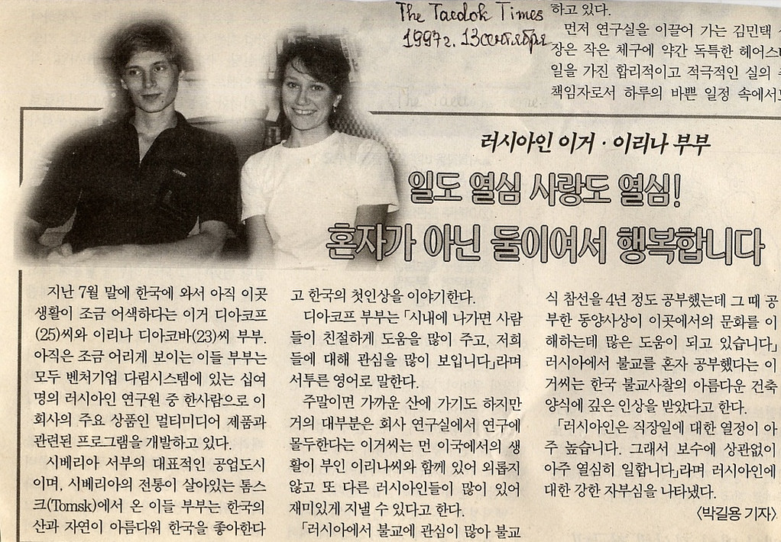
1997: Moved to South Korea

Slide 7
1997-2000 Software Engineer at Darim
Created Windows COM DLL plug-ins
Studied Mac OS programming
Created 1-to-1 Video Conferencing software for Windows using Darim proprietary MPEG video capture boards
Created multi-user distance learning software for Windows. Both realtime (multicast) and on-demand.
Lead team of 4 software engineers

Slide 8
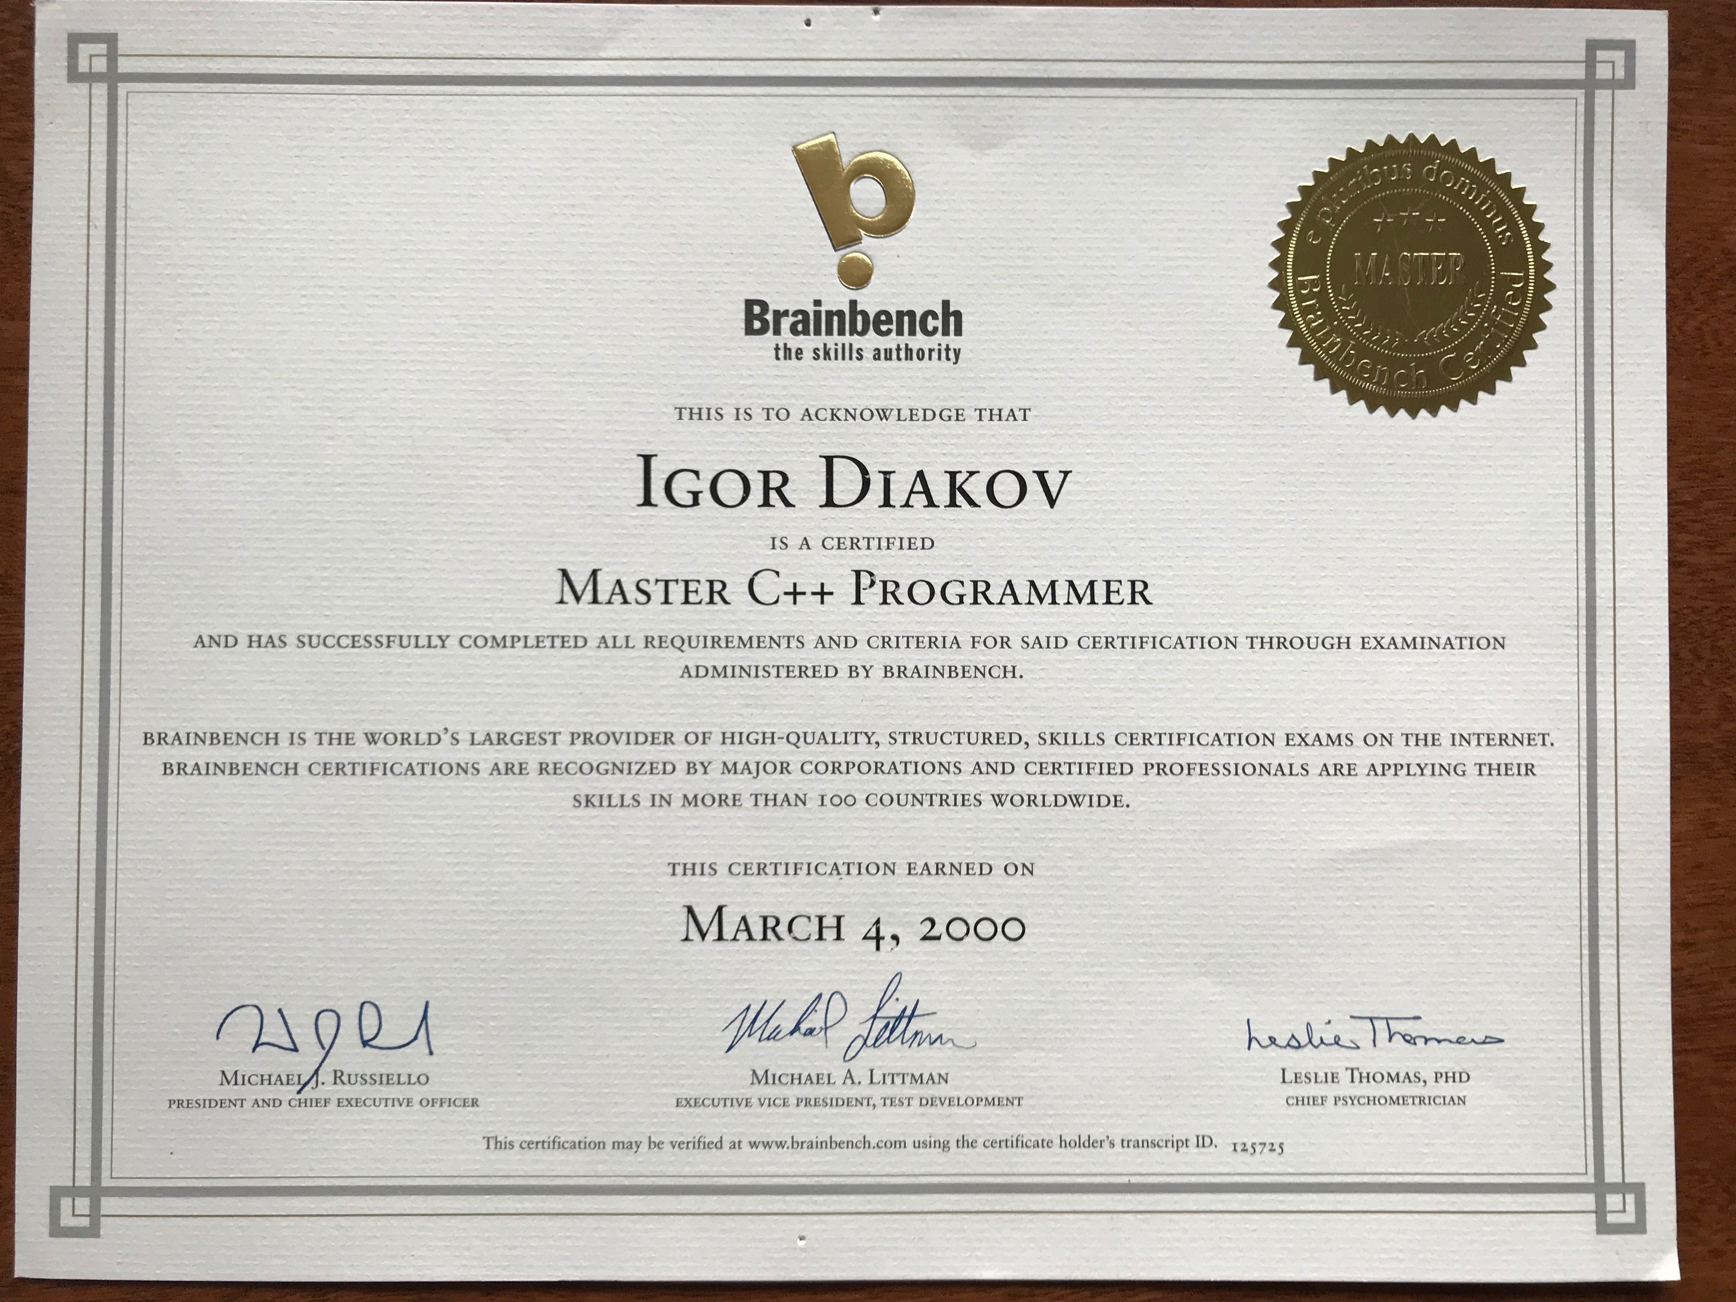
Continued studying C++

Slide 9
2000: Moved to USA

Slide 10
2000-2009: Software Engineer, Architect, Team Lead at Lenel
Windows-based software design & development. Mainly C++, some C#, JavaScript
Integrated third-party hardware into the solution
Designed and implemented software architecture that allowed to increase programmer’s productivity about 100 times
Lead team of 7 software engineers through 4 ship cycles of the software
Defined product architecture; security, test-driven development guidelines, ...

Slide 11
2009: Independent Software Engineer
Studied Cloud technologies: Azure, AWS, Google
Studied programming of cell-phones. Created 13 iPhone apps

Slide 12
2010-Now: Founded DComplex
Designed and implemented high performance distributed cross platform (macOS, Windows, Linux, Android, iOS) video surveillance software
Worked with third parties and licensed it to them

Slide 13
Learning
Udacity: completed Self-Driving Car Nanodegree. Studied 12 AI, ML, DL and etc courses
edx.org, Coursera, …: studied dozens of AI, Computer Vision, Robotics, and etc courses

Slide 14
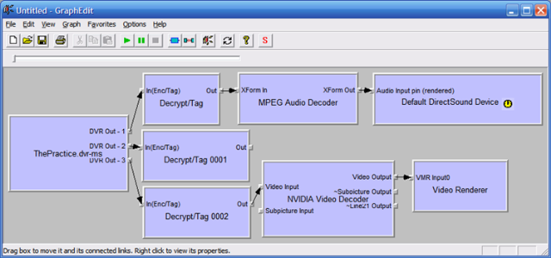
Architecture Example: DirectShow Pictures from Microsoft blog and Amazon

Slide 15
